Slide 1
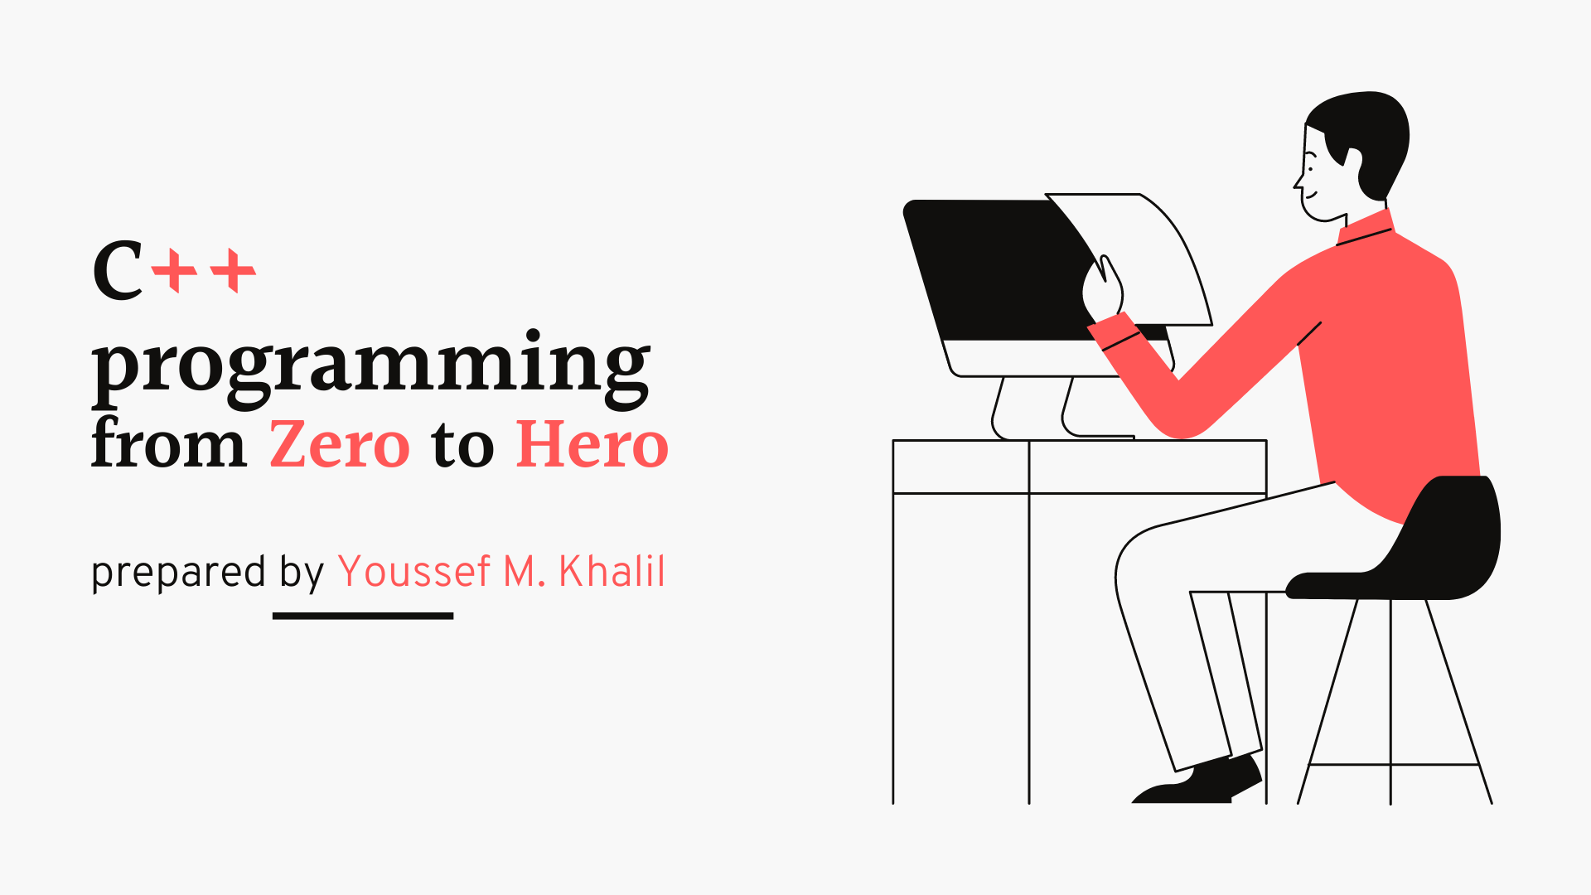

Slide 2
Session Agenda
Introduction
Defining variables
comments
Input / output
If statement
Switch..case
While loop
Do while loop
For loop
Goto

Slide 3
Course instructions
create an account on HackerRank
Watch the videos all attend all the lectures and take notes
Solve the Homework and the examples
try to google or YouTube and the concepts by yourself again to get on the concepts deeply

Slide 4
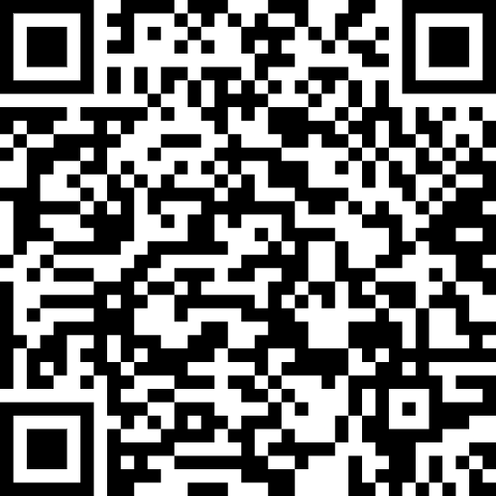
How to get the course materials
All the slides and the code written in the session will be uploaded
On the CS Club GitHub Repo
Please visit:
https://github.com/youssefkhalil320/E-JUST-CS-Club-Materials/tree/main/C%2B%2B%20For%20beginners/Slides
Or Scan this QR code:

Slide 5
I am Struggling
Can not find the best source
Do not know the suitable number of hours for studying
Get disappointed from Errors
Making great Effort and the no reward
I forget coding
Spent a lot of time trying to solve a problem

Slide 6
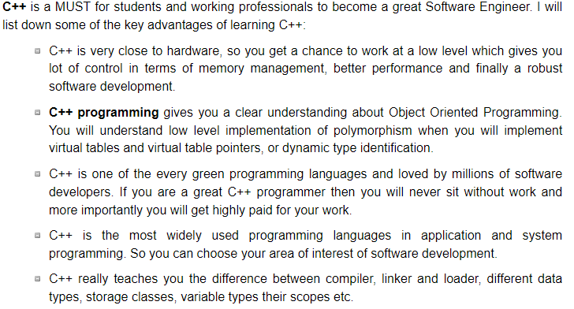
Why to learn c++

Slide 7
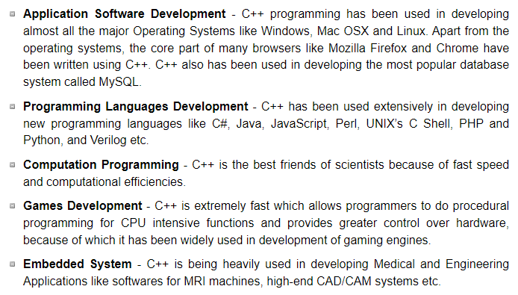
Applications of C++ Programming

Slide 8
For Compiler and IDE Installation
https://www.youtube.com/watch?v=VIkmXi9lRiU
https://www.youtube.com/watch?v=ZixCyiMVFqc
https://www.youtube.com/watch?v=MNJ7aYHCMCo

Slide 9
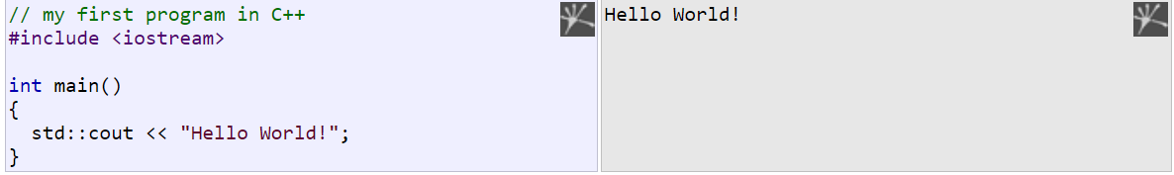
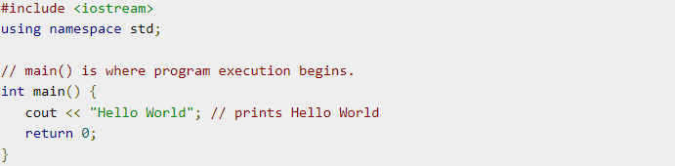
The structure of c++ program

Slide 10
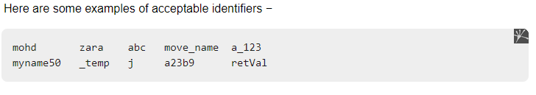
C++ identifiers
A C++ identifier is a name used to identify a variable, function, class, module, or any other user-defined item. An identifier starts with a letter A to Z or a to z or an underscore (_) followed by zero or more letters, underscores, and digits (0 to 9).
C++ does not allow punctuation characters such as @, $, and % within identifiers. C++ is a case-sensitive programming language. Thus, Manpower and manpower are two different identifiers in C++.

Slide 11
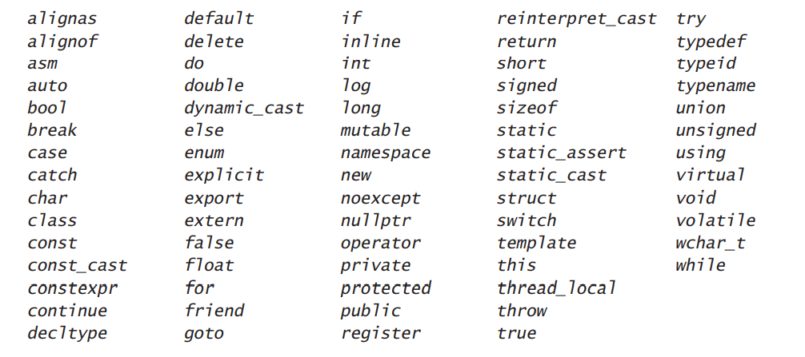
Keywords in c++

Slide 12
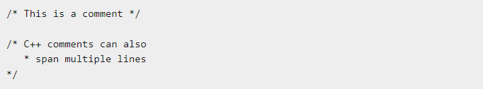
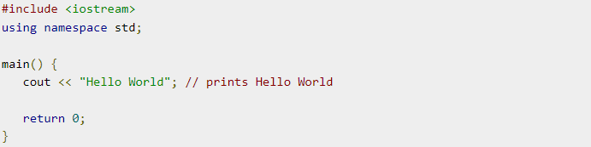
Comments in c++
Program comments are explanatory statements that you can include in the C++ code. These comments help anyone reading the source code. All programming languages allow for some form of comments.
C++ supports single-line and multi-line comments. All characters available inside any comment are ignored by C++ compiler.
C++ comments start with /* and end with */. For example −

Slide 13
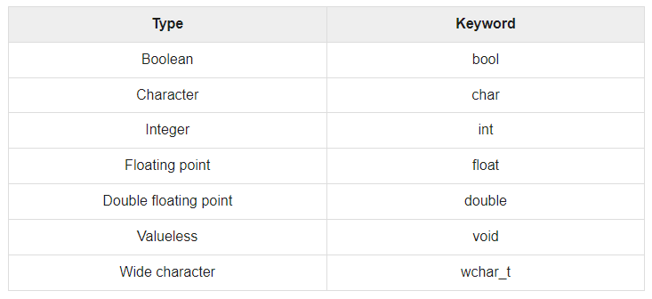
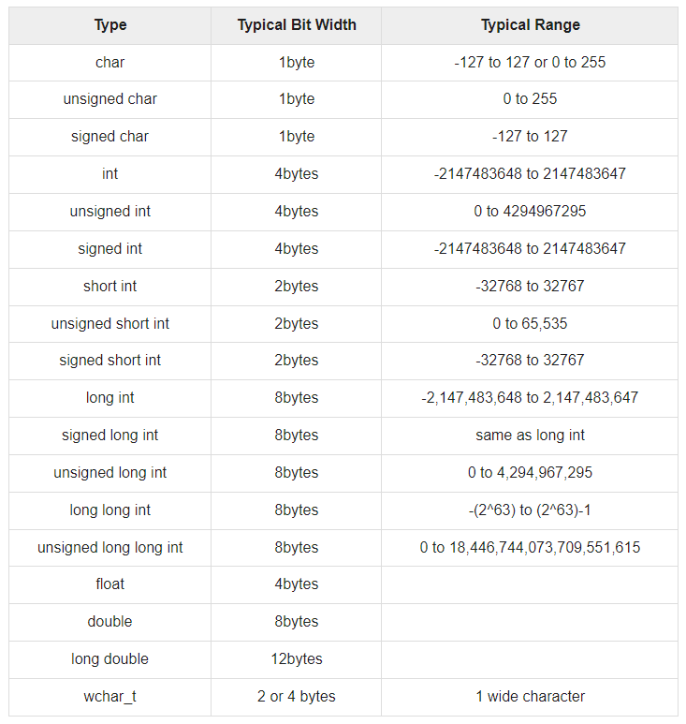
Primitive Built-in Types in c++

Slide 14
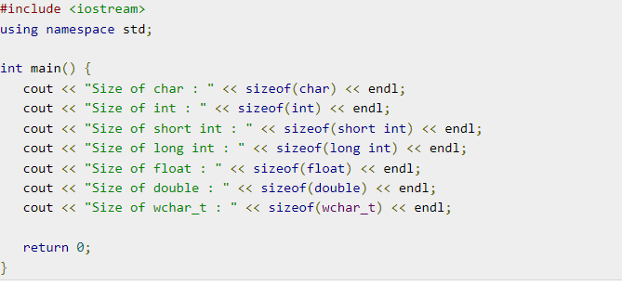
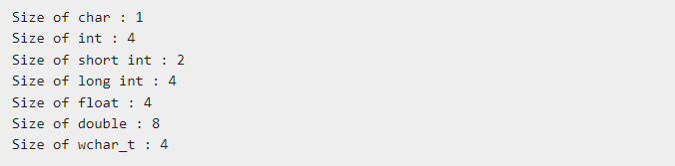
Size of Primitive Built-in Types in c++
Input
output

Slide 15
Size of Primitive Built-in Types in c++
Input
output

Slide 16
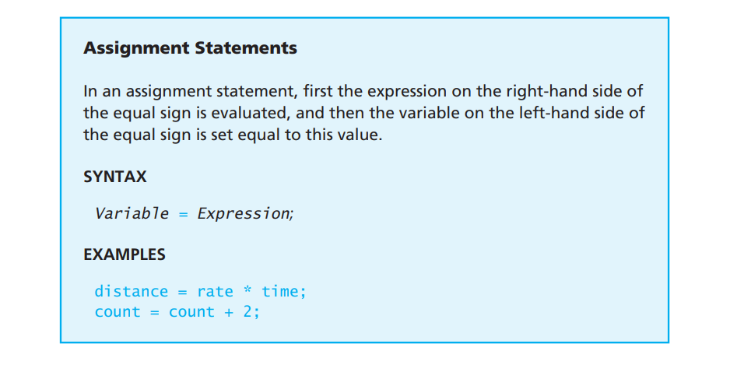
Defining a variable

Slide 17
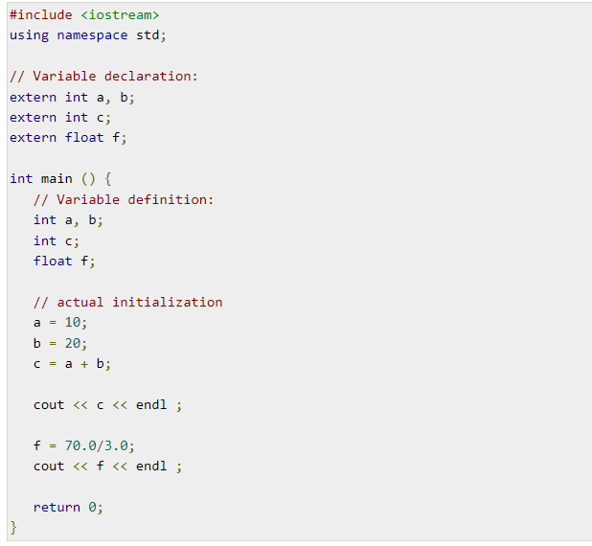
Defining a variable

Slide 18
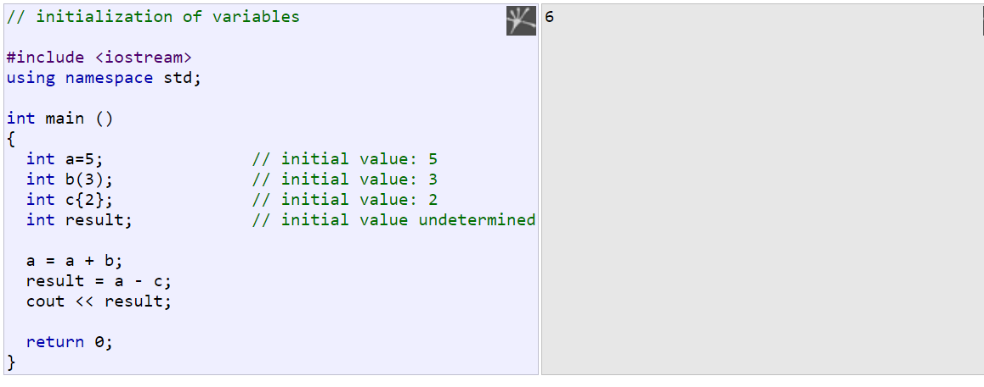
Defining a variable

Slide 19
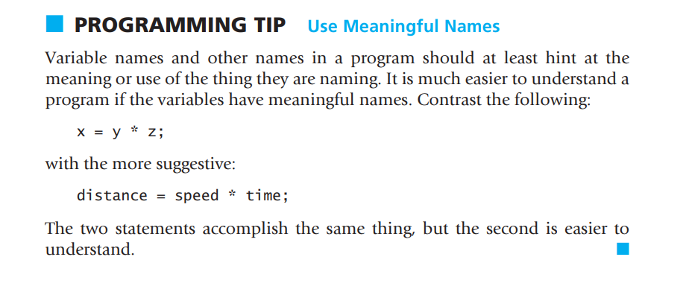
Defining a variable

Slide 20
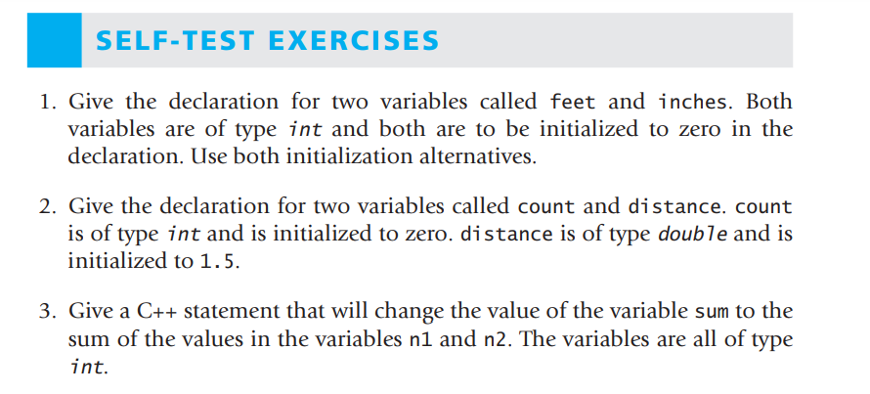
Defining a variable

Slide 21
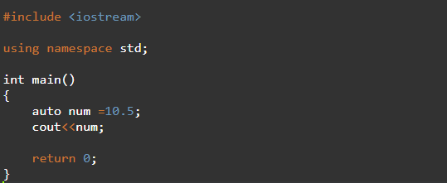
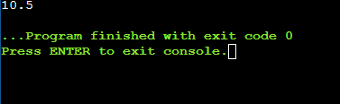
Type deduction: auto and decltype
When a new variable is initialized, the compiler can figure out what the type of the variable is
Automatically by the initializer. For this, it suffices to use auto as the type specifier for the variable

Slide 22
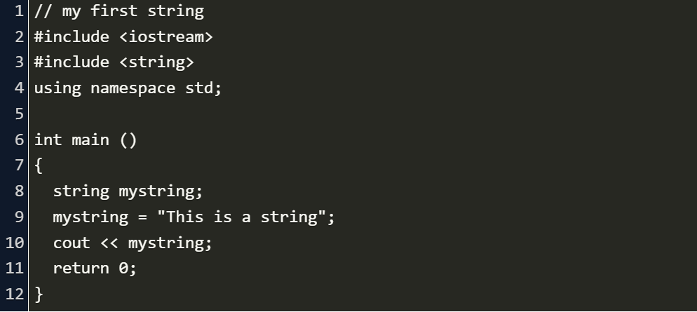
Strings

Slide 23
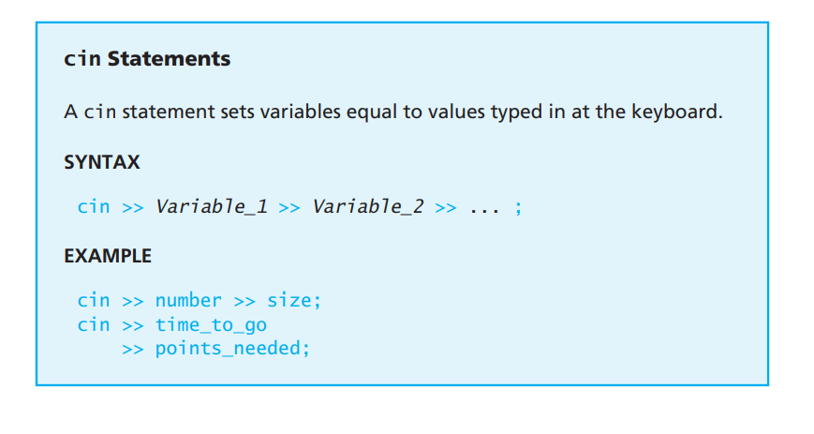
Basic Input/Output

Slide 24
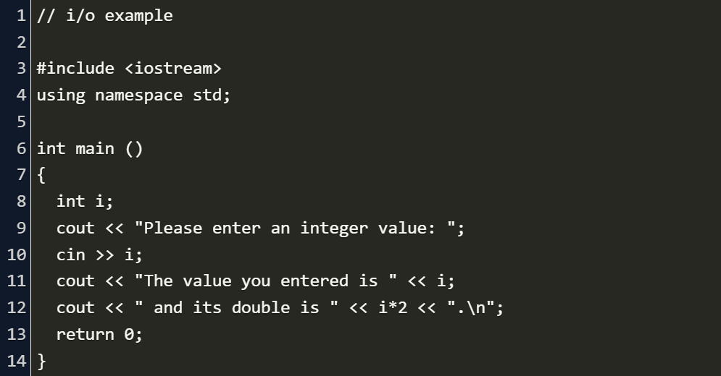
Basic Input/Output

Slide 25
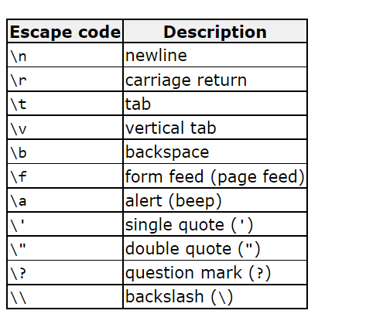
Scape characters

Slide 26
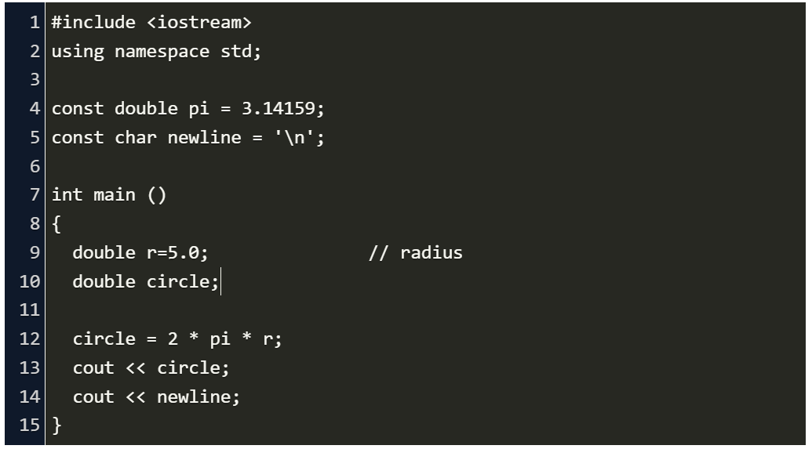
Constant

Slide 27
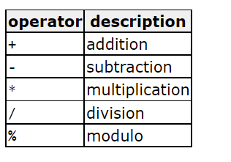
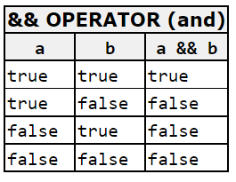
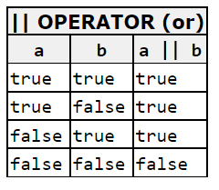
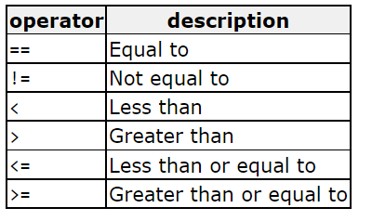
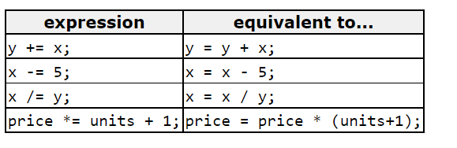
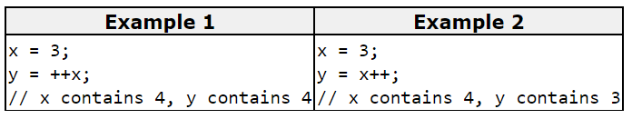
Operators

Slide 28
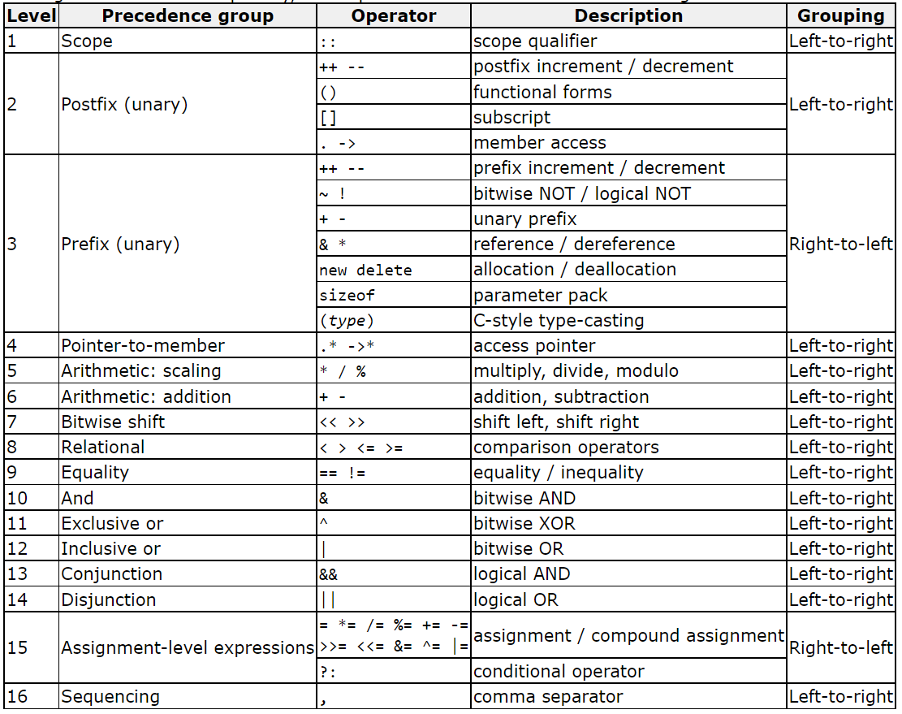
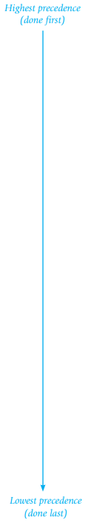
Precedence of operators

Slide 29
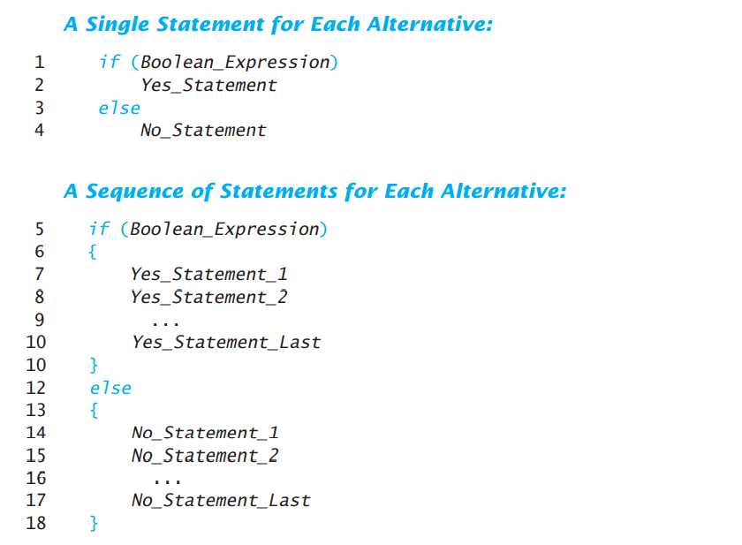
If statement

Slide 30
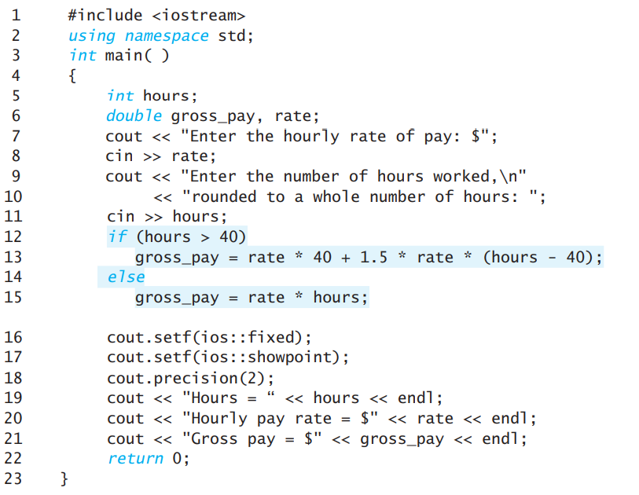
If statement

Slide 31
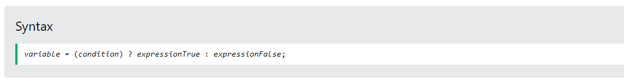
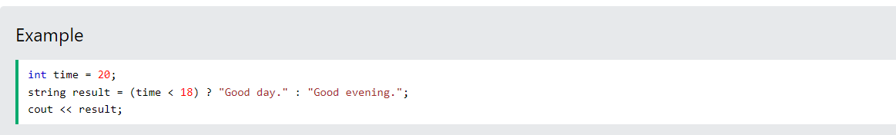
Short Hand If...Else (Ternary Operator)

Slide 32
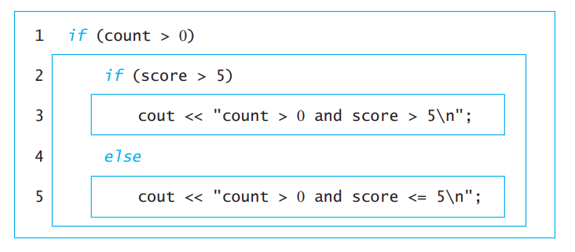
Multiway Branches

Slide 33
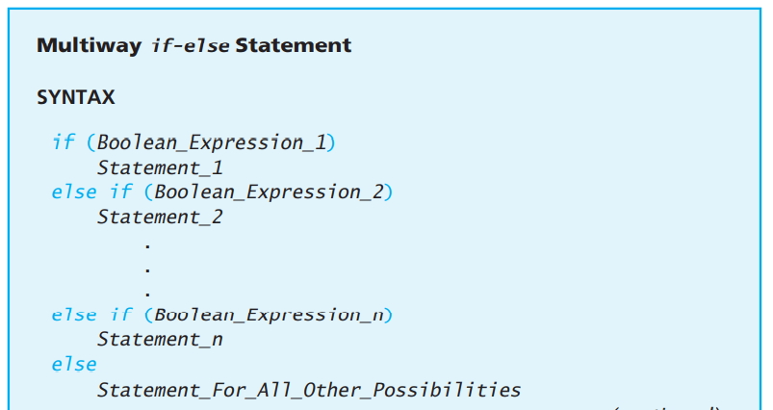
Multiway if-else Statement

Slide 34
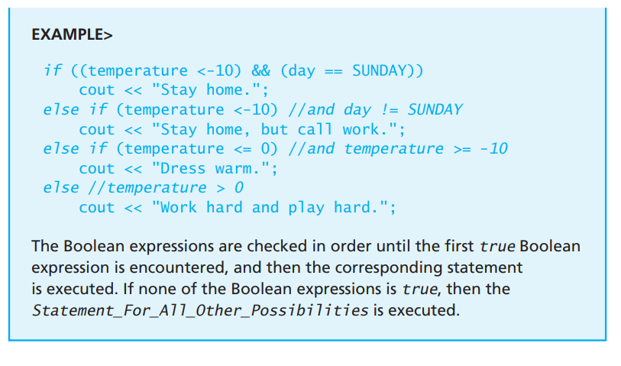
Multiway if-else Statement

Slide 35
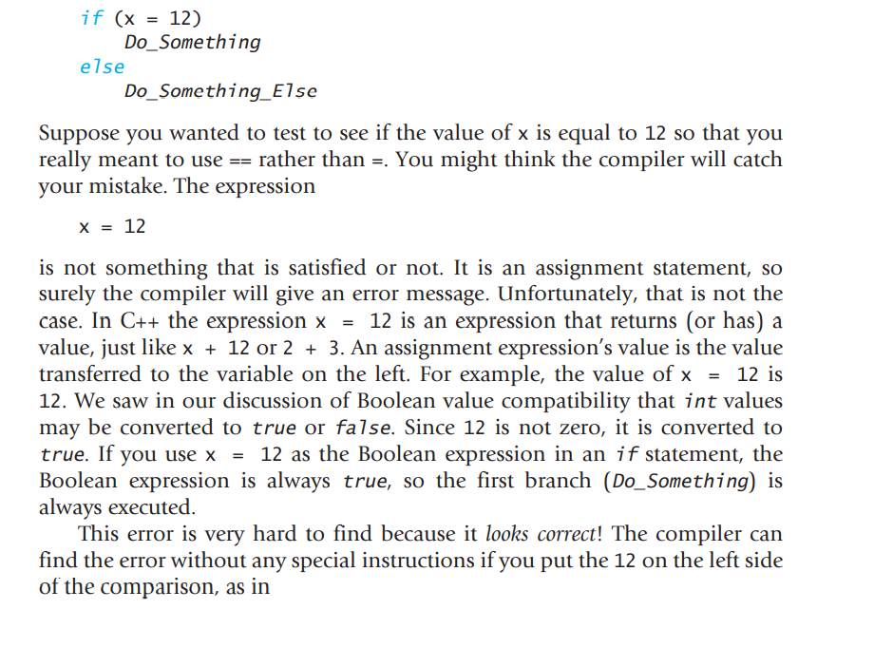
Using = in place of ==

Slide 36
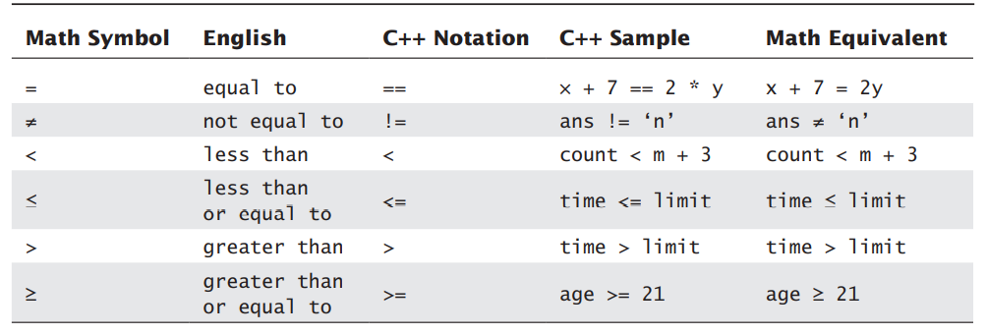
comparison Operators

Slide 37
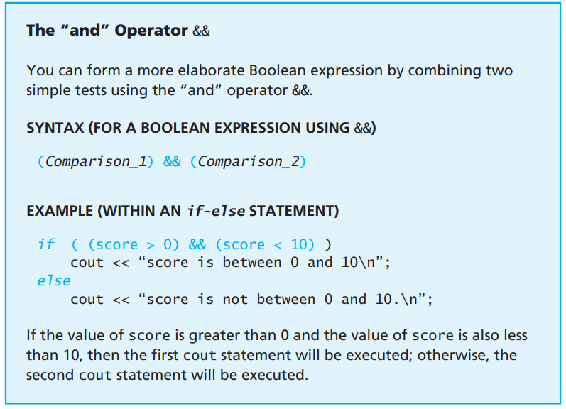
comparison Operators

Slide 38
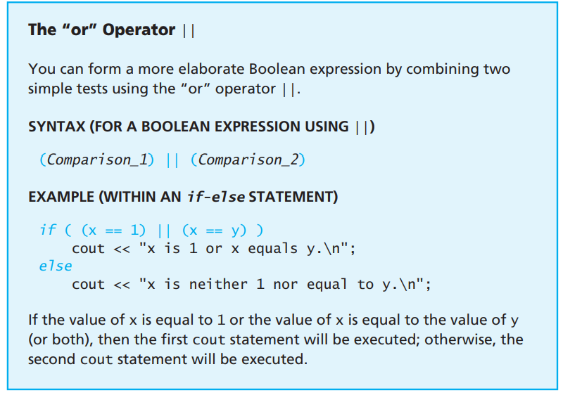
comparison Operators

Slide 39
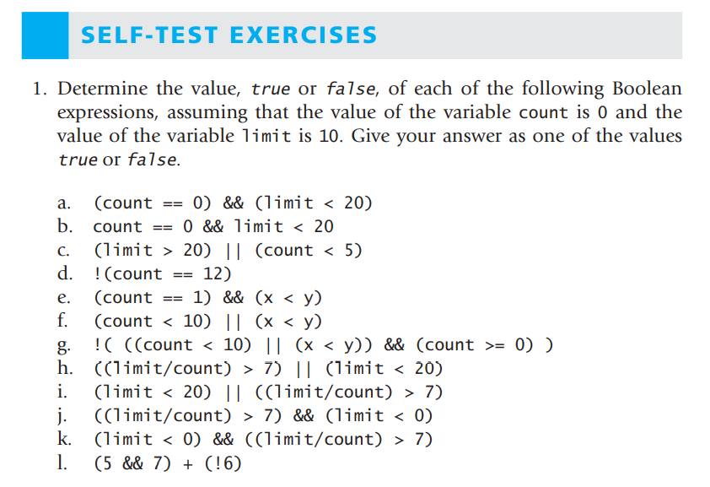
comparison Operators

Slide 40
Homework
https://www.hackerrank.com/challenges/c-tutorial-basic-data-types/problem?isFullScreen=true
https://www.hackerrank.com/challenges/cpp-hello-world/problem?isFullScreen=true
https://www.hackerrank.com/challenges/cpp-input-and-output/problem?isFullScreen=true
https://www.codezclub.com/cpp-program-addition-two-numbers/
https://www.codezclub.com/cpp-calculate-sum-average-three-numbers/
https://www.codezclub.com/cpp-find-size-int-float-double-char/
https://www.codezclub.com/cpp-check-number-odd-even/
https://www.codezclub.com/cpp-convert-days-years-weeks-days/
https://www.codezclub.com/cpp-program-find-largest-number/

Slide 41
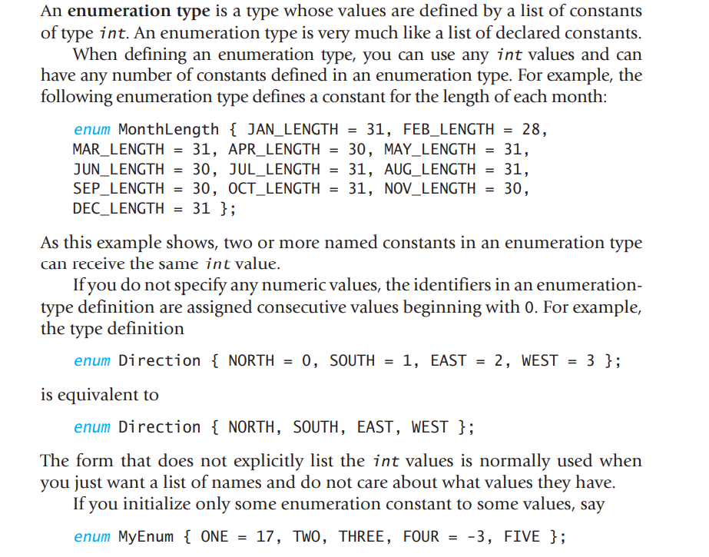
C++ Enumeration

Slide 42
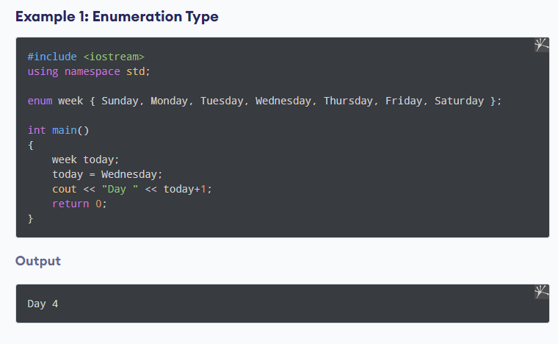
C++ Enumeration

Slide 43
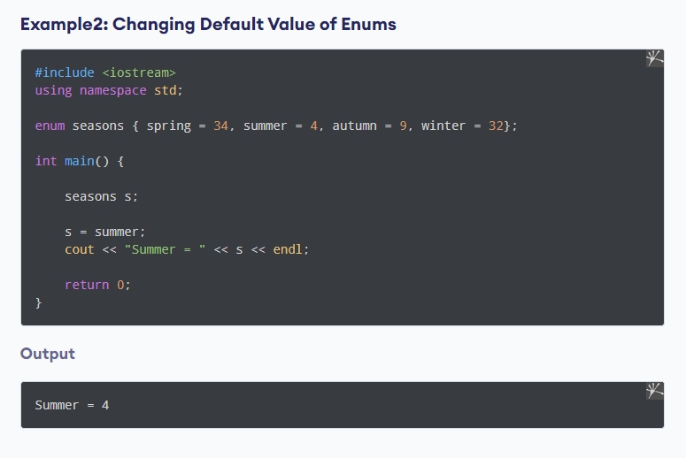
C++ Enumeration

Slide 44
Using = in place of ==

Slide 45
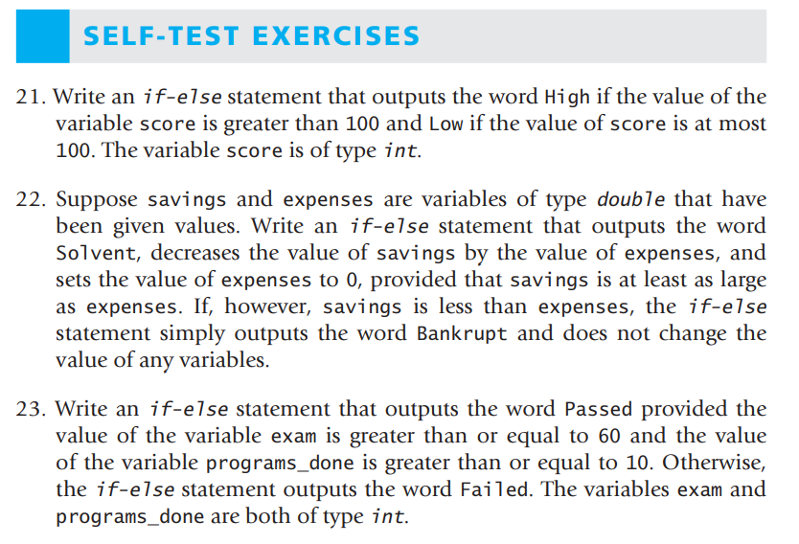
If statement

Slide 46

C++ Switch Statements

Slide 47

C++ Switch Statements

Slide 48

C++ Switch Statements

Slide 49


C++ Switch Statements

Slide 50

While statement

Slide 51

While statement

Slide 52

While statement

Slide 53

Do...While statement

Slide 54

Do...While statement

Slide 55

Do...While statement

Slide 56

Do...While statement

Slide 57


C++ for Loop

Slide 58

C++ for Loop

Slide 59

C++ for Loop

Slide 60

C++ for Loop

Slide 61
C++ for Loop

Slide 62

C++ for Loop

Slide 63

C++ for Loop

Slide 64

loops

Slide 65


C++ Break and Continue

Slide 66


C++ Break and Continue

Slide 67
C++ Break and Continue

Slide 68

Time to practice

Slide 69

Time to practice

Slide 70

C++ goto Statement

Slide 71
C++ goto Statement

Slide 72


C++ goto Statement

Slide 73
Homework
https://www.codezclub.com/cpp-convert-uppercase-string-lowercase/
https://www.codezclub.com/cpp-convert-uppercase-character-lowercase/
https://www.codezclub.com/cpp-count-words-string/
https://www.codezclub.com/cpp-program-reverse-string/
https://www.hackerrank.com/challenges/c-tutorial-for-loop/problem?isFullScreen=true

Slide 74
Sources
Books:
-Problem Solving with C++ ninth edition
Websites:
-Geeks for Geeks
-Tutorials point
-programiz
-w3schools
-cplusplus.com
- CodezClub
- HackerRank

